Slide 1
AtliQ Motors – Electric Vehicle Analysis
Code Basics Resume Project Challenge #12
Presented by : Pooja Sangwan

Slide 2

Company’s background
AtliQ Motors
US-based electric vehicle leader
Over the past five years, they captured 25% of the North American electric and hybrid vehicle market.

Slide 3
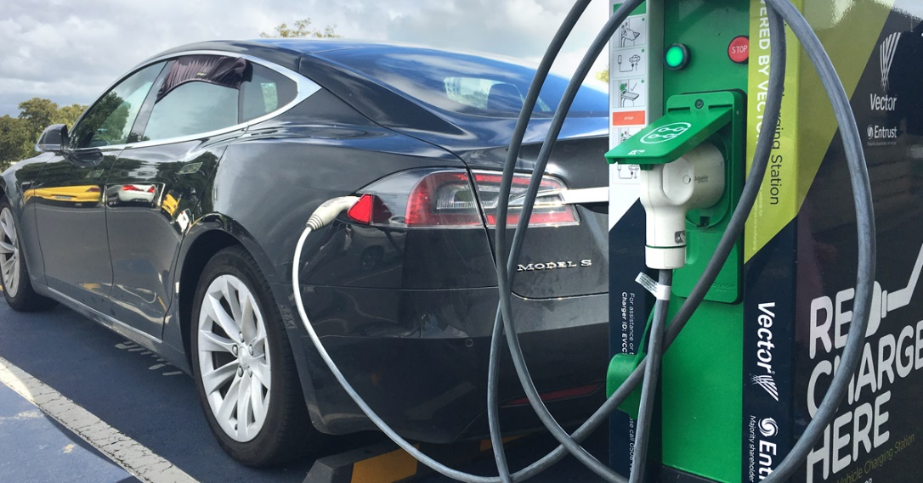
Problem Statement
AtliQ Motors is an automotive giant from the USA specializing in electric vehicles (EV). In the last 5 years, their market share rose to 25% in electric and hybrid vehicles segment in North America. As a part of their expansion plans, they wanted to launch their bestselling models in India where their market share is less than 2%. Bruce Haryali, the chief of AtliQ Motors India wanted to do a detailed market study of existing EV/Hybrid market in India before proceeding further.

Slide 4
Dataset Details
Dataset contain 3 excel file:
Dim_date
Electrical_vehicle_sales_by_makers
Electrical_vehicle_sales_by_states
Primary and secondary questions pdf
Metadata (provides additional information about the dataset)
Supporting documents.

Slide 5
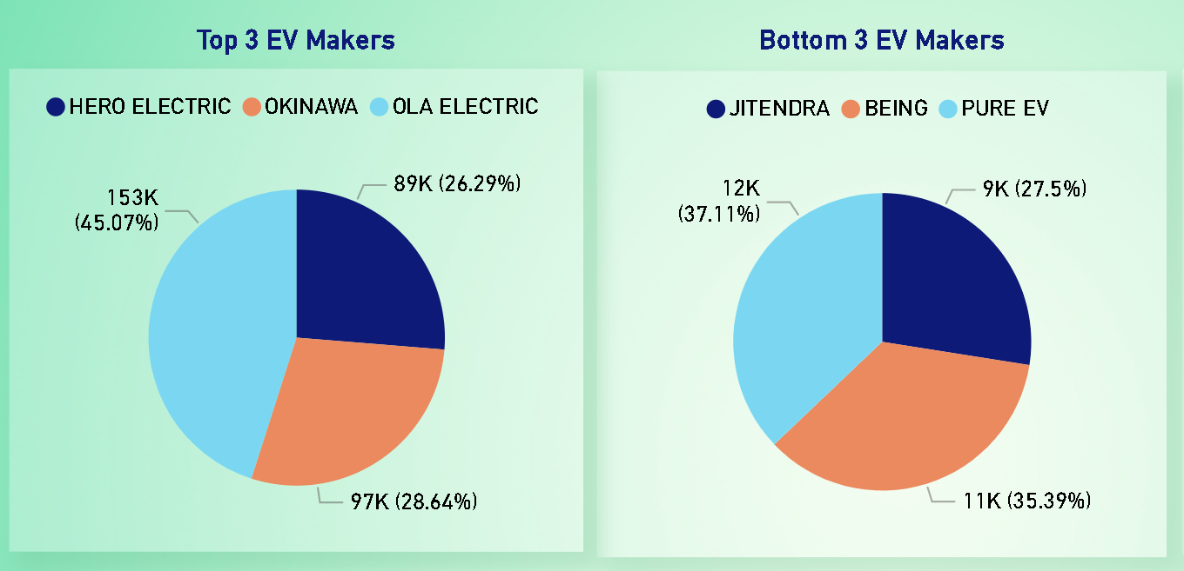
Que 1. List the top 3 and bottom 3 makers for the fiscal years 2023 and 2024 in terms of the number of 2-wheelers sold.
2023
Insight : Which manufacturers are leading and which are facing challenges?

Slide 6
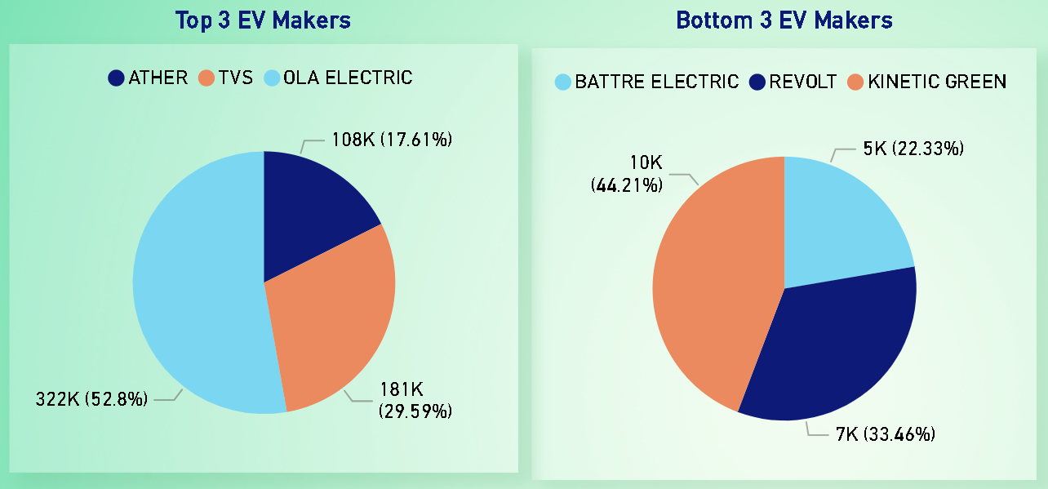
Que 1. List the top 3 and bottom 3 makers for the fiscal years 2023 and 2024 in terms of the number of 2-wheelers sold.
2024
Insight : Which manufacturers are leading and which are facing challenges?

Slide 7
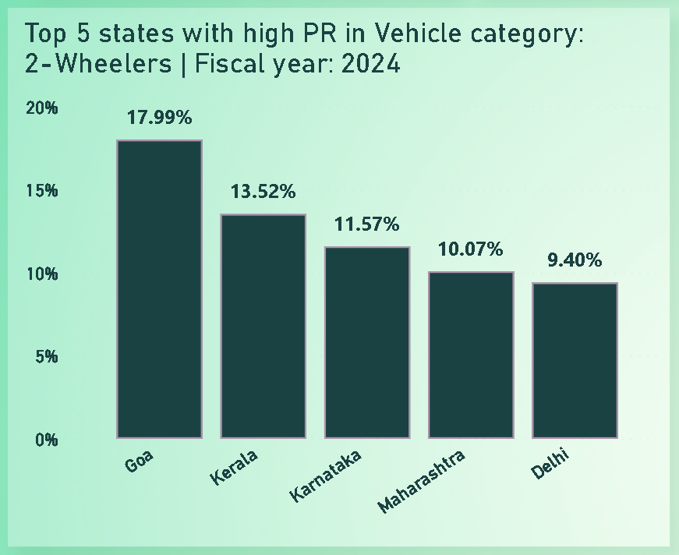
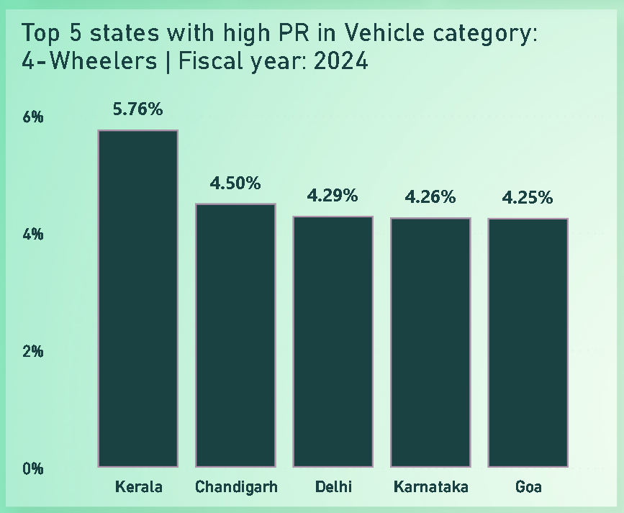
Que 2. Identify the top 5 states with the highest penetration rate in 2-wheeler and 4-wheeler EV sales in FY 2024.
Insight : According to PR of states, we can find which state is best to start the business and in which vehicle category.

Slide 8
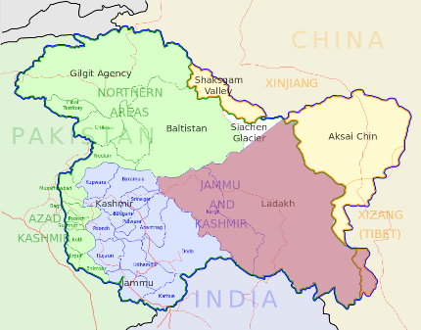

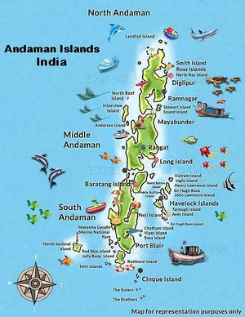

Que 3. List the states with negative penetration (decline) in EV sales from 2022 to 2024?
(2-Wheeler)
(4-Wheeler)
Insight : Atliq should take this decline rate into account & develop a suitable strategy to run the business & prevent potential pitfalls.

Slide 9
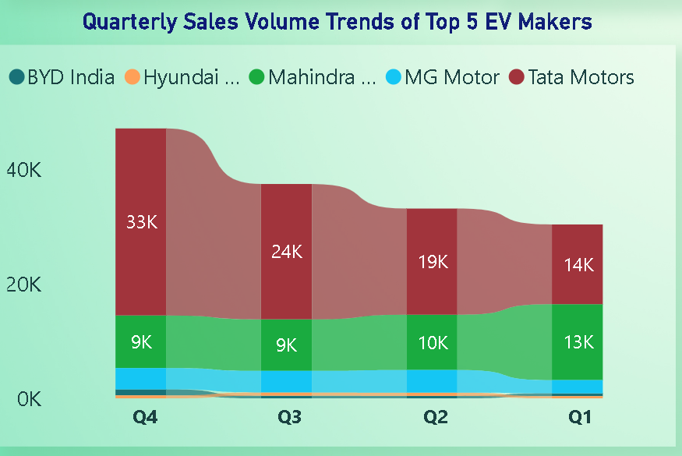
Que 4. What are the quarterly trends based on sales volume for the top 5 EV makers (4-wheelers) from 2022 to 2024?
Insight : Which manufacturers are leading and which are facing challenges? The 4-wheeler market is led by Tata Motors.

Slide 10
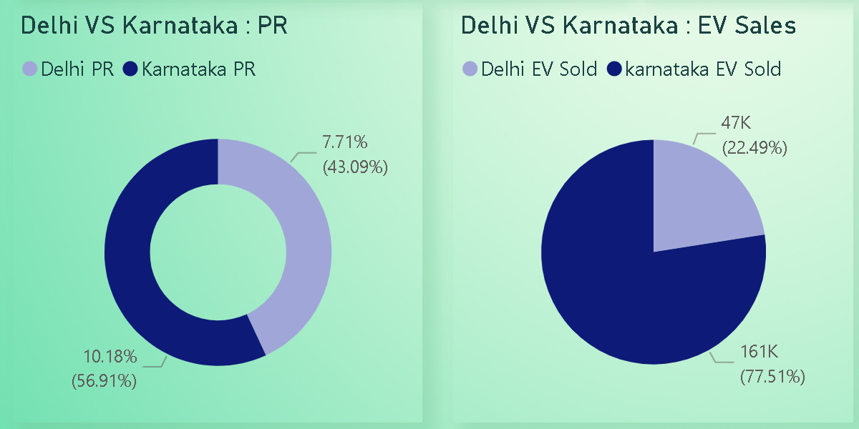
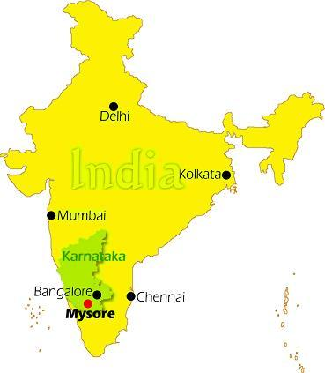
Que 5. How do the EV sales and penetration rates in Delhi compare to Karnataka for 2024?
Insight : EV sales are higher in Karnataka than in Delhi because Karnataka's larger geographical size contributes to more sales.

Slide 11
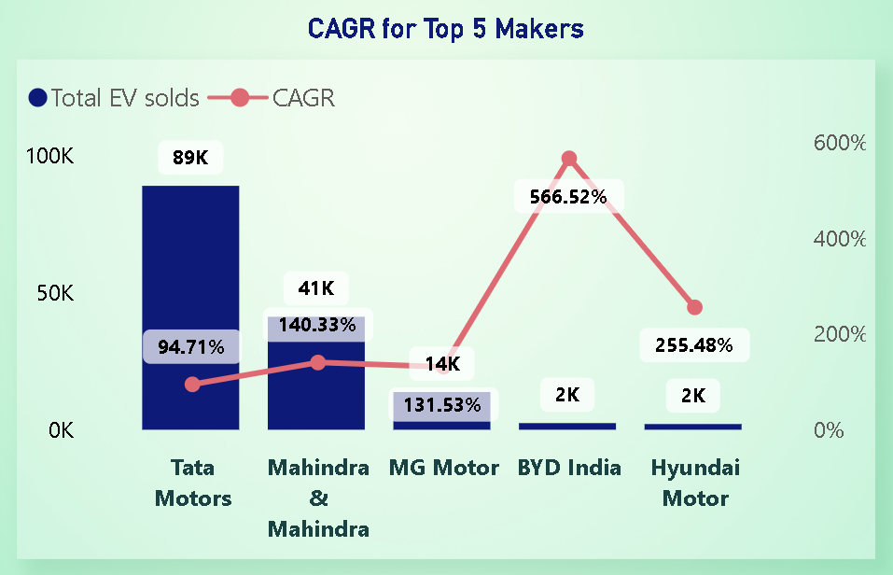
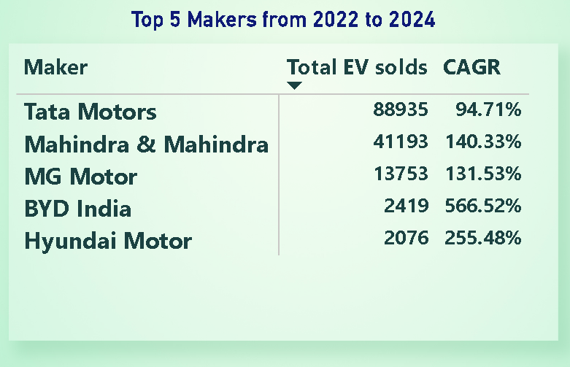
Que 6. List down the compounded annual growth rate (CAGR) in 4-wheeler units for the top 5 makers from 2022 to 2024.
Insight : CAGR giving us a way as to how a maker is performing over a specific period of time. BYD India is outperforming other makers in CAGR.

Slide 12
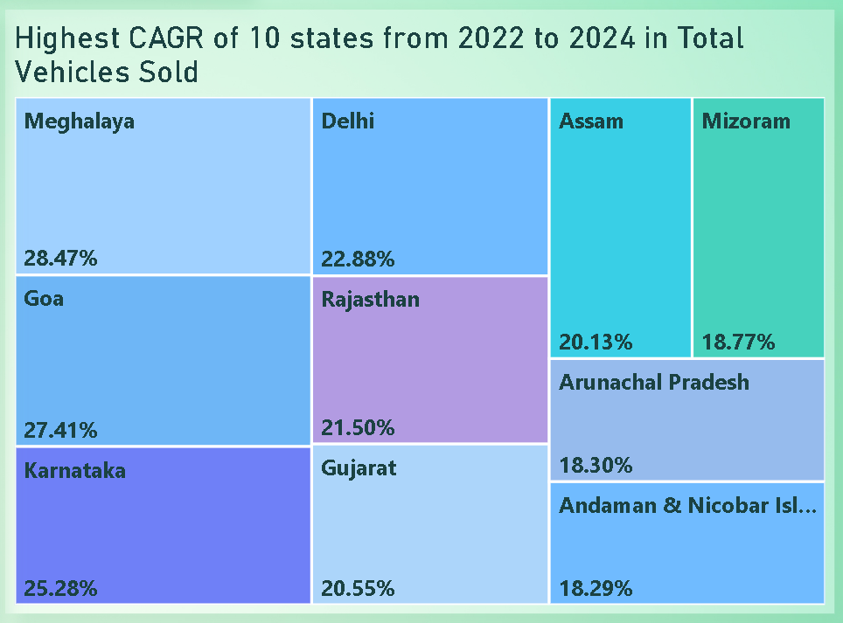
Que 7. List down the top 10 states that had the highest compounded annual growth rate (CAGR) from 2022 to 2024 in total vehicles sold.
Insight : Based on CAGR, companies can invest more in growing markets, expand into areas with rising demand, and create new products or partnerships to match future growth in the EV industry.

Slide 13
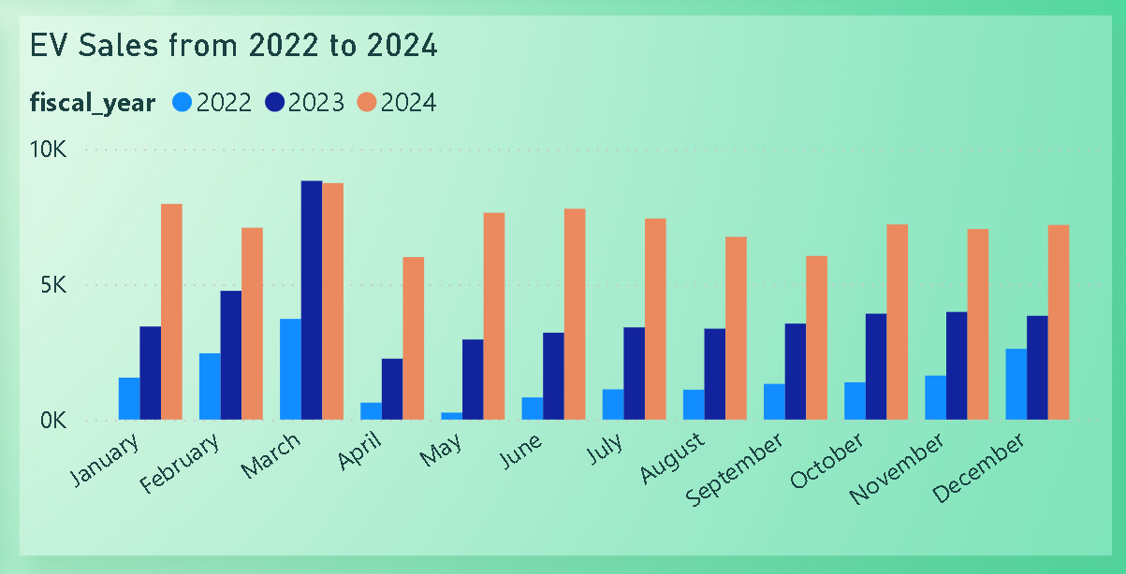
Que 8. What are the peak and low season months for EV sales based on the data from 2022 to 2024?
Insight : March sees the highest EV sales, while April and May are slower, so paying attention to customer behavior is essential for the business.

Slide 14
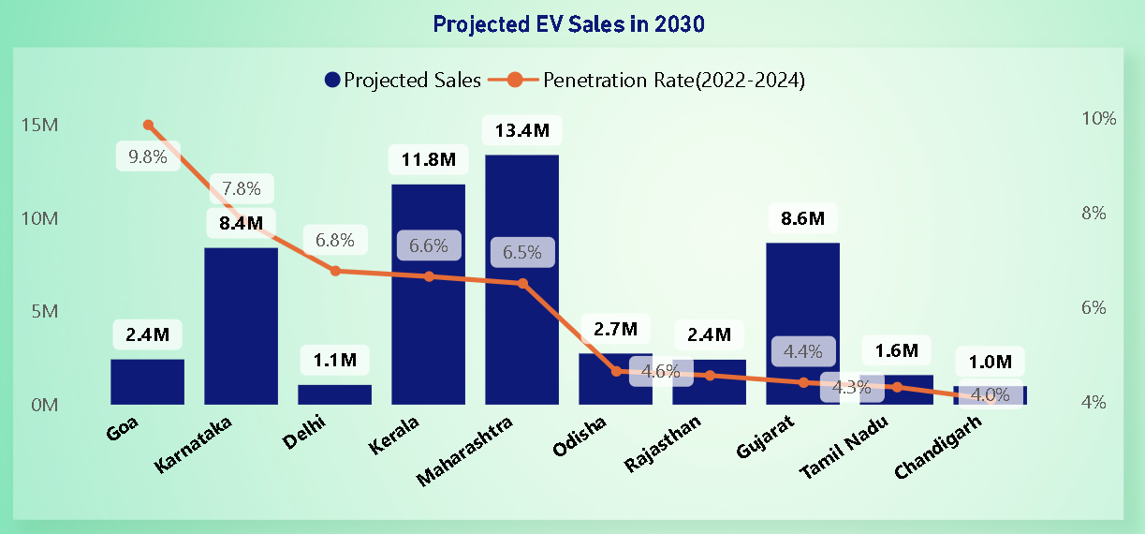
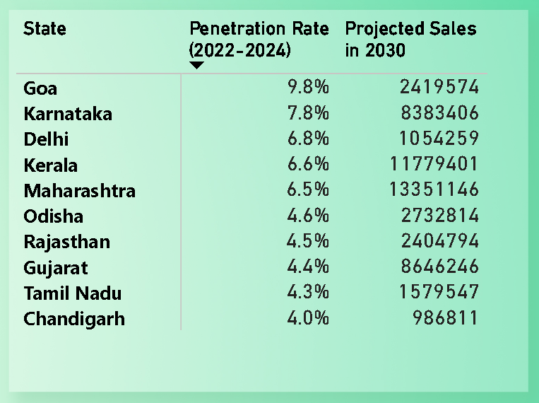
Que 9. What is the projected number of EV sales (including 2-wheelers and 4-wheelers) for the top 10 states by penetration rate in 2030, based on the compounded annual growth rate (CAGR) from previous years?
Insight : The projected EV sales by 2030 show where the market will grow, helping to focus investment and strategy.

Slide 15
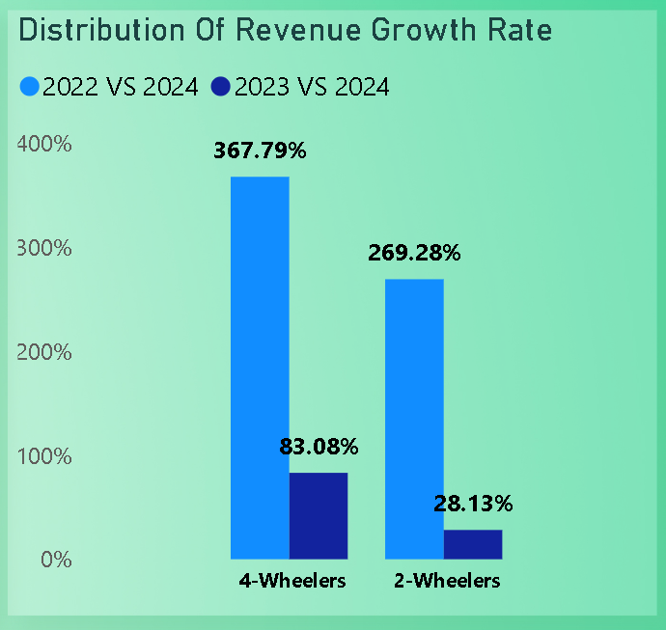
Que 10. Estimate the revenue growth rate of 4-wheeler and 2-wheelers EVs in India for 2022 vs 2024 and 2023 vs 2024, assuming an average unit price of 2-Wheelers is ₹ 85,000 and 4-Wheelers is ₹ 15,00,000.
Insight : Revenue growth rate for 2022 vs 2024 contributed more profit rather than 2023 vs 2024. The reason behind this is FAME II(Faster Adoption and Manufacturing of Hybrid and Electric Vehicles) subsidy Scheme.
The FAME 2 scheme in India offers financial incentives to promote electric vehicle adoption and support charging infrastructure development. This helps lower EV costs, accelerate the transition to clean energy, and reduce pollution.

Slide 16
Secondary Research Questions: Que 1. What are the primary reasons for customers choosing 4-wheeler EVs in 2023 and 2024 (cost savings, environmental concerns, government incentives)?
Cost savings: Lower fuel and maintenance costs.
Environmental concerns: Desire to reduce carbon footprint.
Government incentives: Tax credits and rebates lower upfront costs.
Technological advancements: Improved range, performance, and charging times.
Increased model availability: More options from trusted brands.

Slide 17
Que 2. How do government incentives and subsidies impact the adoption rates of 2-wheelers and 4-wheelers? Which states in India provided most subsidies?
Subsidies reduce the purchase price, making EVs more affordable, boosting adoption.
Government support signals long-term commitment, encouraging both consumers and manufacturers.
Subsidies for manufacturers lower production costs, supporting a domestic EV industry.
Key states offering significant subsidies: Maharashtra, Delhi, Gujarat, Karnataka, and Tamil Nadu.

Slide 18
Que 3. How does the availability of charging stations infrastructure correlate with the EV sales and penetration rates in the top 5 states?
The availability of charging station infrastructure has a strong positive correlation with EV sales and penetration rates in the top 5 states. Here’s how they are related:
Increased Convenience: More charging stations reduce range anxiety, boosting EV sales.
Higher Penetration Rates: States with better infrastructure have higher EV adoption rates.
Market Confidence: Well-developed charging networks increase consumer confidence in EVs.
Support for Long-Distance Travel: Availability of fast chargers makes EVs viable for longer trips.
Top State Examples: Maharashtra, Delhi, Gujarat, Karnataka, and Tamil Nadu see higher EV adoption due to expanding charging infrastructure.

Slide 19

Que 4. Who should be the brand ambassador if AtliQ Motors launches their EV/Hybrid vehicles in India and why? Dia Mirza should be the Brand Ambassador for Atliq Motors as she has been the face of many pivotal environment campaigns across India. She has been appointed as UN Environment’s Goodwill Ambassador of India. She has been vocal about using renewable sources of energy as it is more efficient and eco-friendly.

Slide 20
Que 5. Which state of India is ideal to start the manufacturing unit? (Based on subsidies provided, ease of doing business, stability in governance etc.)
Karnataka is often considered the most ideal state to start an EV manufacturing unit in India, based on several factors:
Good Subsidies: Karnataka offers strong financial incentives for EV manufacturing.
Easy Business Setup: The state makes it simple to get permits and approvals.
Stable Government: Consistent support for businesses ensures long-term stability.
Strong Industry Base: Existing automotive industry provides skilled workers and suppliers.
Strategic Location: Close to ports and markets for easier exports.

Slide 21
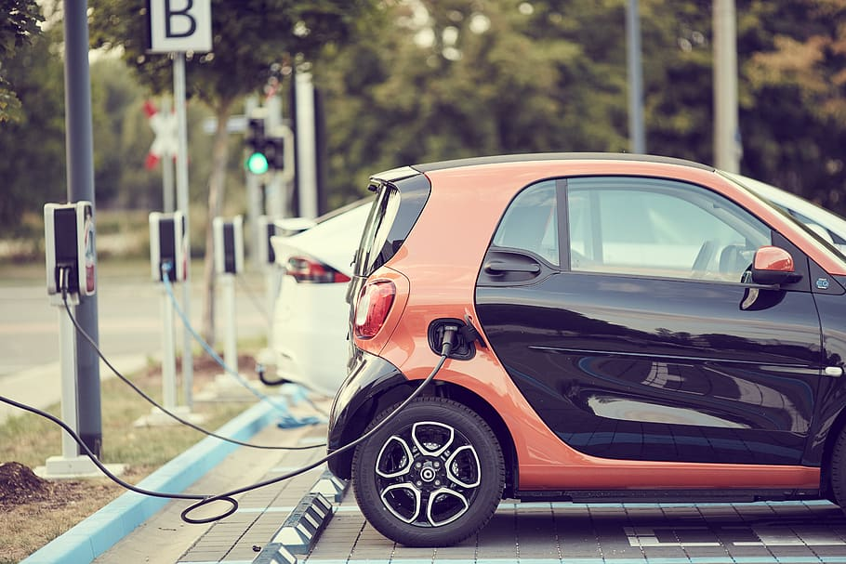
Que 6. Your top 3 recommendations for AtliQ Motors.
After analysing the sales trends, 2 wheelers e-vehicle is dominating in market as compare to the 4 wheelers e-vehicle, so we need to plan the marketing strategies to spread awareness through Auto Expo or advertisements.
Atliq motors should follow two way strategies to focus on production of e-vehicles as well as on maintenance of e-vehicles/charging station.
Finding advance technologies in recycling of the e-vehicle batteries as Atliq motors is the promising company supporting eco-friendly methods and building customer confidence for long-lasting loyalty.

Slide 22


